Slide 1
Lessons Learned From Running an HPSS Globus Endpoint
Lisa Gerhardt
Jeff Porter
Nick Balthaser
HPSS User Forum
September 1, 2016

Slide 2
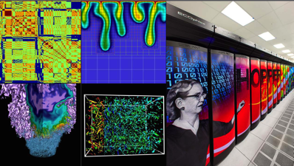
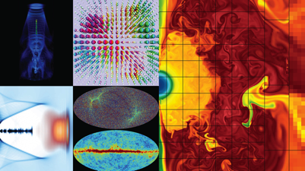
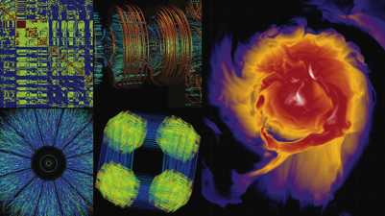
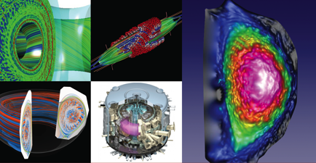
NERSC is the Production HPC & Data Facility for DOE
Largest funder of physical science research in U.S.
Biological and Environmental Systems
Applied Math, Exascale
Materials, Chemistry,
Geophysics
Particle Physics, Astrophysics
Nuclear Physics
Fusion Energy,
Plasma Physics
Notes:
NERSC is the primary scientific computing facility for the Office of Science in the U.S. Department of Energy.
6000 users from more than 700 projects. Roughly 200 referred publications per year.

Slide 3
NERSC - 2016
Edison: Cray XC-30
7.6 PB Local Scratch
163 GB/s
136 GB/s
/project
7 PB
DDN SFA12KE
Sponsored Storage
2.4 PB
DDN SFA12KE
16x FDR IB
34 GB/s
5,576 nodes, 133K, 2.4GHz Intel “IvyBridge” Cores, 357TB RAM
Cori: Cray XC-40
28 PB Local Scratch
>700 GB/s
270 TB
NetApp EF560/E5500
5 GB/s
/home
2PB “DataWarp” I/O Accl. Layer
>1.5 TB/s
HPSS
115 PB stored, 240 PB capacity, 40 years of community data
16 GB/s
Ph1: 1630 nodes, 2.3GHz Intel “Haswell” Cores, 203TB RAM
Ph2: >9300 nodes, >60cores, 16GB HBM, 96GB DDR per node
32x FDR IB
Data-Intensive Systems
PDSF, JGI,KBASE,Materials
14x QDR IB
Ethernet &
IB Fabric
Science Friendly Security
Production Monitoring
Power Efficiency
WAN
2 x 10 Gb
1 x 100 Gb
Data Transfer Nodes
Adv. Arch. Testbeds Science Gateways
Software Defined
Networking

Slide 4
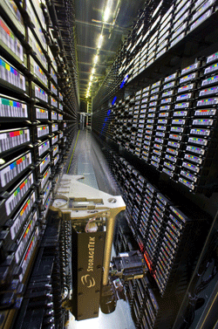
The HPSS Archive at NERSC
The NERSC HPSS archive is a Hierarchical Storage Management system (HSM) that has been at NERSC since 1998
Critical part of many groups data management and retention strategies
Currently holds 83 PB* of data
Roughly 100 TB of I/O per day
Average 126.5 TB / month transferred via Globus endpoint (2015)
Also use hsi, htar, pftp to transfer
* User system only. With Center backups 115PB across 2 HPSS systems

Slide 5
gridFTP/HPSS at NERSC
gridFTP/HPSS interface has been in production at NERSC since HPSS 5.x mid 2000s
HPSS 5.x pre-DSI gridFTP authentication code for PFTP developed in-house
HPSS 6.2 DSI developed at ANL
enabled at NERSC in 2009
nersc#hpss GO endpoint enabled 2012 but disabled after HPSS 7.3 upgrade 03/2013
HPSS 7.3.3 DSI developed at NCSA
nersc#hpss GO endpoint re-enabled 09/2013 after extensive re-testing
Currently (2016) moves ~ 25 TB/day (21.5 TB = ALCF project)

Slide 6
Two Different Worlds
Globus: Data in motion, splits into multiple streams. Goal: Get where you’re going ASAP
HPSS: Data at rest, slow accrual over time.
Goal: Preserve important data indefinitely

Slide 7
Lesson 1: Death By A Thousand Cuts
“Drag & Drop” transfers are a breeze with Globus’ GUI and users frequently use this to store or retrieve 1,000s – 10,000s of files simultaneously
In HPSS files can end up scattered across hundreds of tapes, retrieving without ordering can cause major slow downs
Using hsi, can order retrievals to get all files off of each tape in order

Slide 8
Facility Defense: Automated script
No Globus solution available, so devised a stop-gap
Automated script that detects ingest of small files
Mines gridFTP xfer log to count files transferred by users in a sliding time threshold based on per day transfers
Automatically opens a user help ticket in our Service Now system alerting the user that they are using HPSS inefficiently
Depending on rate of transfer, can also ban user from further HPSS transfers, user must respond before access is restored

Slide 9
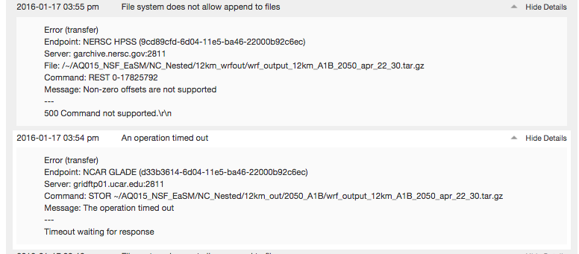
Lesson 2: Death By Repetition
Interrupted transfers are automatically resumed and Globus tries to pick up file where it left off
This can cause sparse files in HPSS
This feature (REST) is disabled in the NERSC gridFTP/HPSS server
Get endless streams of retries as Globus tries to send a partial file and HPSS rejects it:
Notes:
DSI layer doesn’t properly return information about where the data chunk stopped

Slide 10
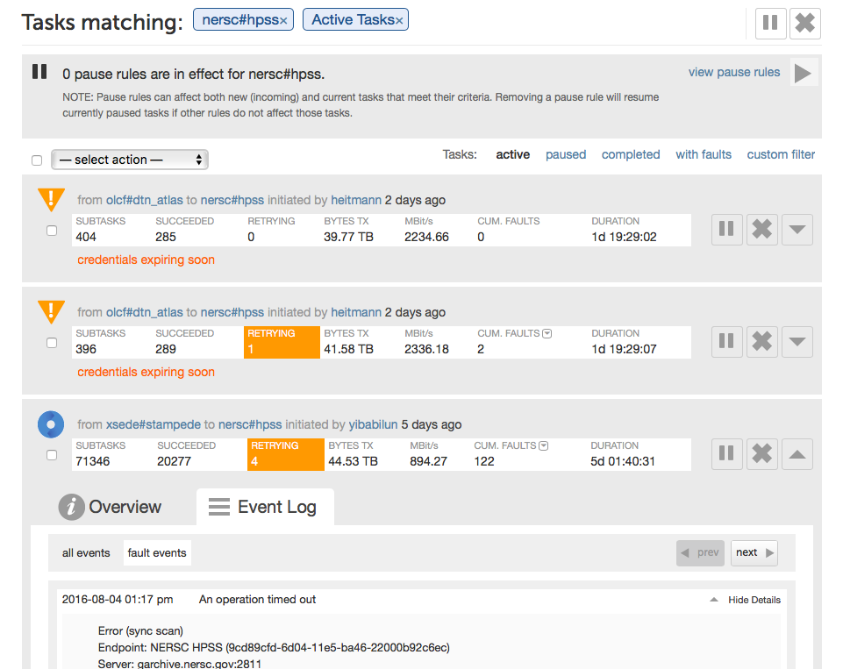
User and Task Administration: Globus Console
Globus provides friendly web interface for task management

Slide 11
Facility Defense: Use Globus API to Automatically Block
Script queries Globus API to get number of failures per transfer
If over threshold, uses Globus Administrator powers to pause transfer
Gets NERSC user name from API and automatically opens a ticket so user can investigate the problem
Still working on this last bit, Globus just implemented this functionality

Slide 12
Lesson 3: Don’t Cross the Streams
Internal transfers via Globus to HPSS a factor of 2 – 5 slower than using hsi / htar to transfer
Reason for this not well understood
Expect some slow down for the DSI layer to translate from gridFTP to HPSS, but not a factor of 2

Slide 13
A Two-Factor Solution
For large data transfers into HPSS, use Globus to transfer to intermediate spinning disk at NERSC
Once there use hsi / htar to put data into HPSS
Fastest, but very inconvenient

Slide 14
Globus and HPSS Will Be Crucial
Long term data retention is becoming a must for scientists
The need for a smooth connection between HPSS and Globus will be crucial
Fruitful collaboration with Globus to develop and improve the Globus / HPSS interface, hope it can continue

