Slide 1
Jack Deslippe
GPU Science Day(s) Welcome

Slide 2
What is GPU for Science Day(s)
An Introduction to GPUs and Related Technologies for the Uninitiated
A Sharing Place for Experiences, Expertise, Tips and Tricks For All
A Celebration of Science Achievement Using GPUs and HPC
An Opportunity to Experience GPU Development First Hand
An Expression of the Initiative and Enthusiasm of LBNL PostDocs

Slide 3
GPUs are the Near Future of DOE HPC
GPUs will provide the bulk of performance at NERSC, ALCF and OLCF in the near future.
Why?
Performance Potential Per Watt Greatly Exceeds That of Traditional General Purpose CPU Systems.
NERSC
NVIDIA/Cray (2020)
2021
Argonne
Intel/Cray
(2021)
ORNL
AMD/Cray
(2021)

Slide 4
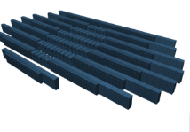
NERSC Systems Roadmap
NERSC-10
ExaSystem
~20MW
NERSC-9: Perlmutter
3-4x Cori
CPU and GPU nodes
>5 MW
Optimized for Science
NERSC-8: Cori
30PFs
Manycore CPU
4MW
NERSC-7: Edison
2.5 PFs
Multi-core CPU
3MW
2013
2016
2020
2024

Slide 5
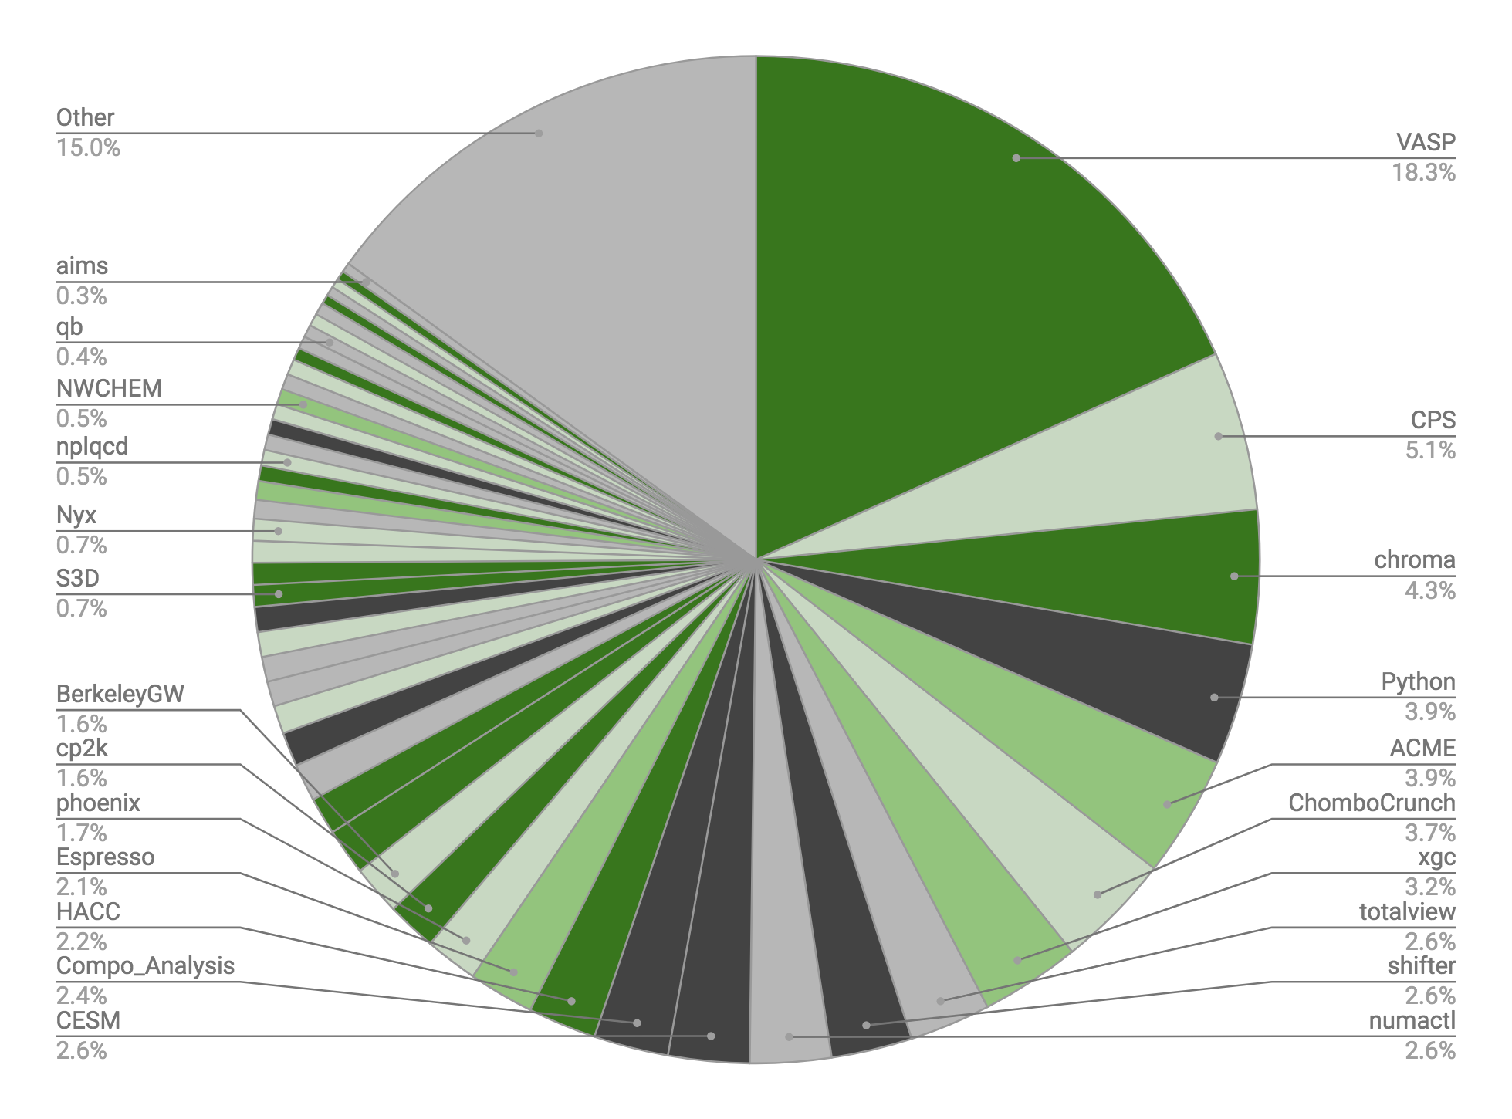
Why GPUs Now at NERSC?
Breakdown of Hours at NERSC
GPU Status & Description | Fraction
Enabled: Most features are ported and performant | 32%
Kernels: Ports of some kernels have been documented. | 10%
Proxy: Kernels in related codes have been ported | 19%
Unlikely: A GPU port would require major effort. | 14%
Unknown: GPU readiness cannot be assessed at this time. | 25%

Slide 6
Our Common Challenge
How to enable a diverse community of 7,000 users, 750 projects, and 700 codes to run on advanced architectures like Perlmutter, Frontier, Aurora and beyond?

Slide 7
Agenda
Day 1: Plenaries and Invited Technical Presentations on GPU Science, Programming Models and Case Studies
Day 2: Hands on Tutorials and Practical Sessions on Developing, Running and Profiling GPU Code.
Hackathon challenge in Day 2 afternoon. Chance to win one of two NVIDIA Jetson Nano Developer Kits

Slide 8
Safety

Slide 9
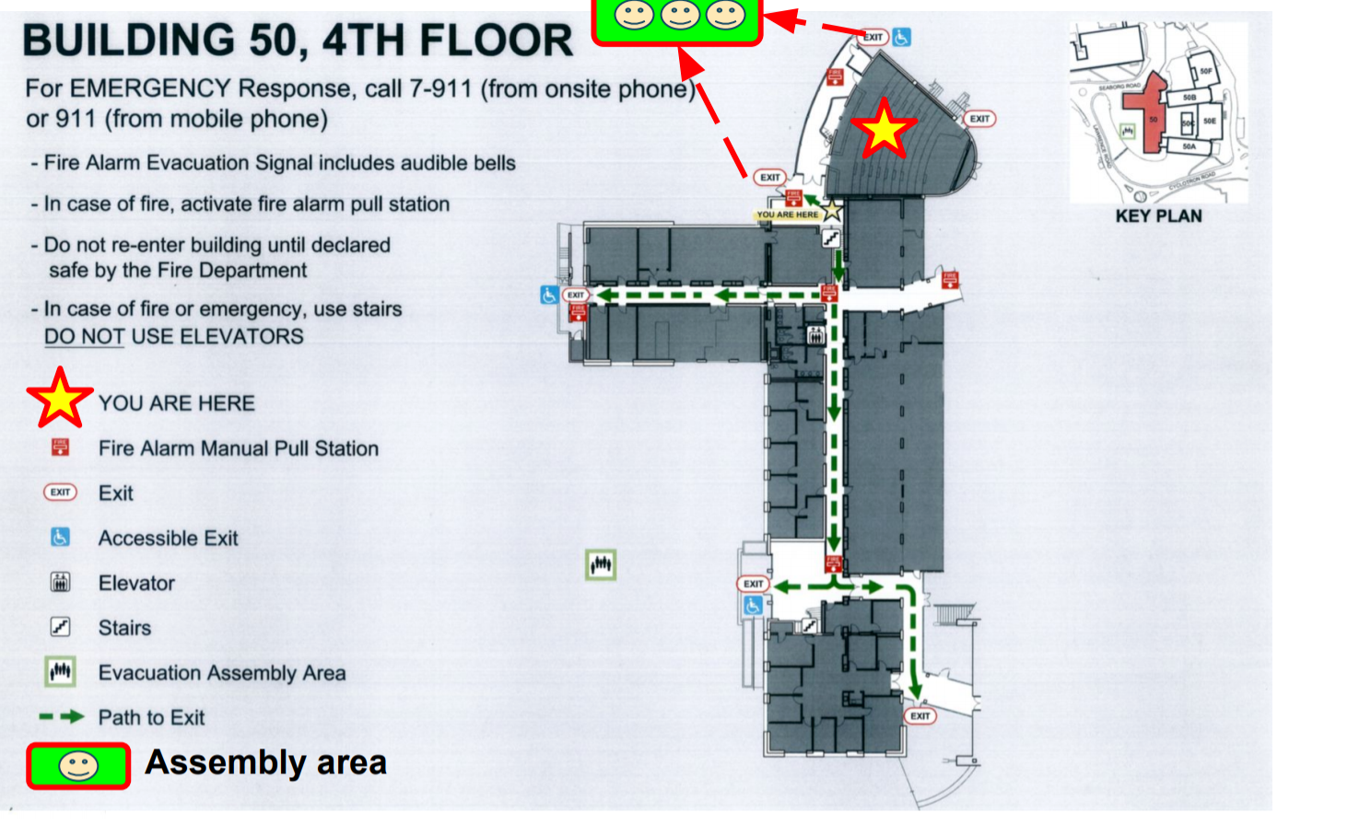
Evacuation Route

Slide 10
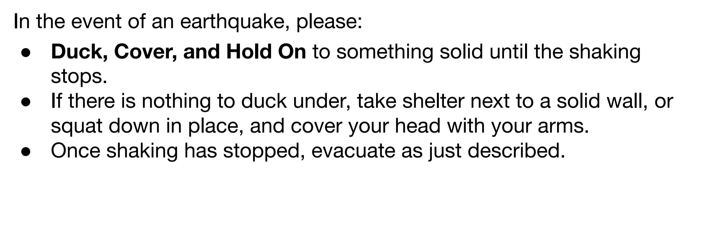
Earthquake Safety

Slide 11
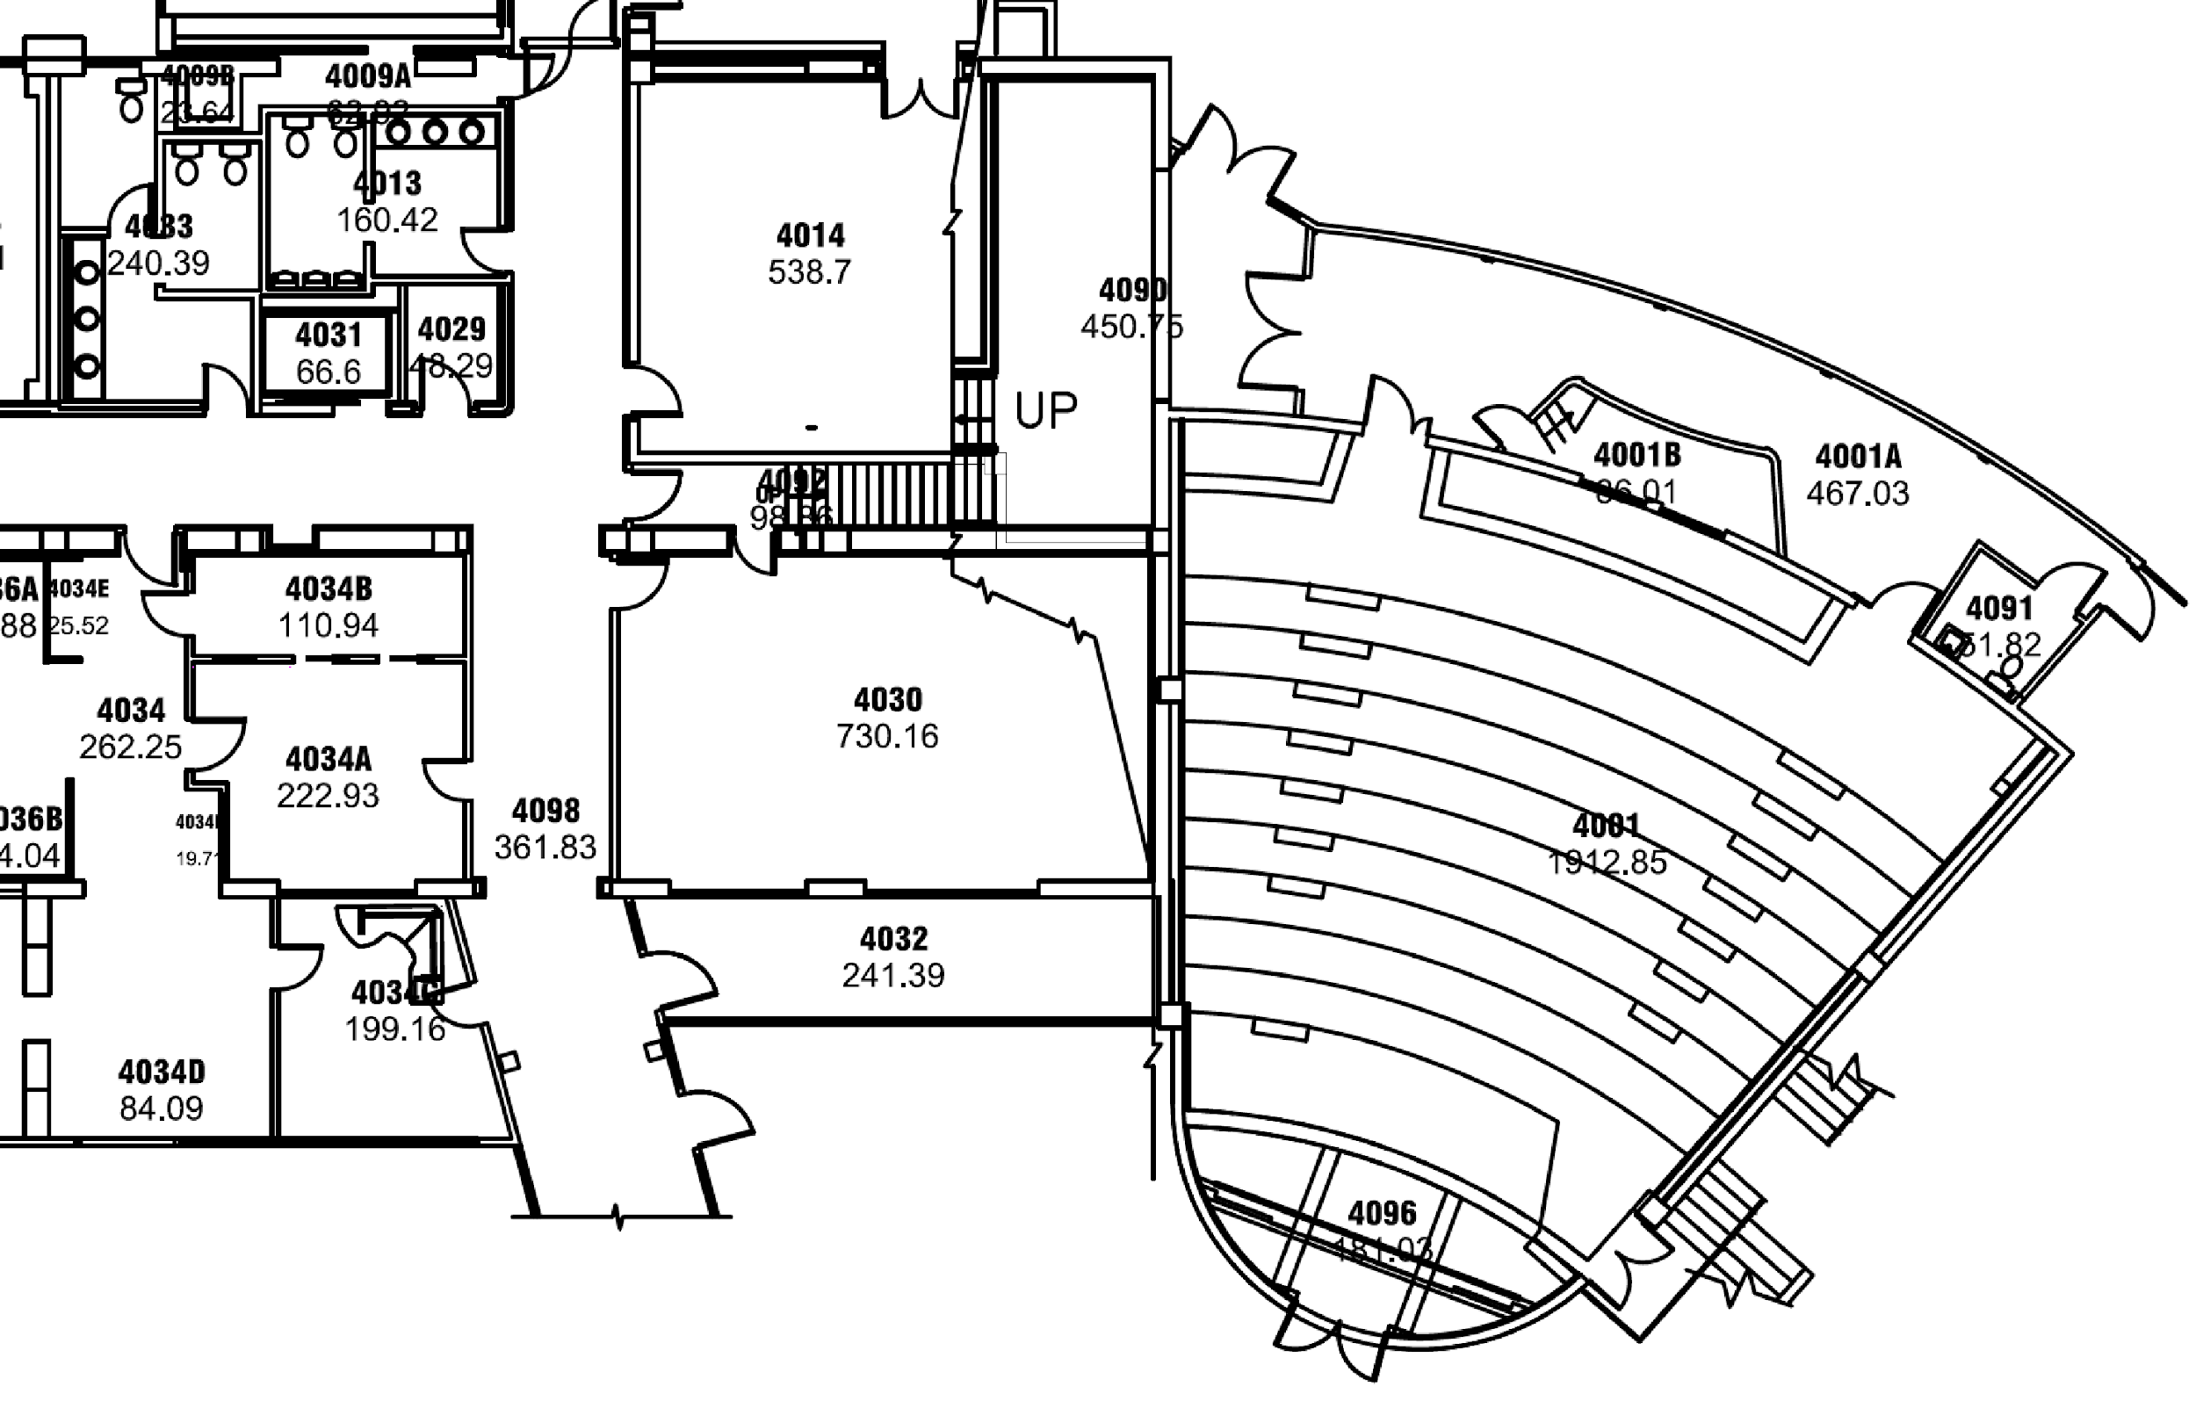
Restrooms
Restrooms are located on floors 4, 5 and 6 on the corner of each floor, just off of the stairs by the auditorium.
Men’s
Women’s
Gender Inclusive and Accessible

Slide 12
Assisted listening devices
This auditorium is equipped with assisted listening devices. We have 9 receivers available at the front of the room.
Speakers, please be sure to use the microphone during your presentation. During Q&A please make sure questions are asked through a handheld microphone.

